Slide 1
Keep it Open: Building Public Sites in the Wild
Victoria Lungu
University of Michigan
School of Information
This work is licensed under the Creative Commons Attribution 3.0 Unported License. To view a copy of this license, visit http://creativecommons.org/licenses/by/3.0/ or send a letter to Creative Commons, 444 Castro Street, Suite 900, Mountain View, California, 94041, USA.

Slide 2
What is Creative Commons?
A form of licensing NOT a form of copyright
But it can be used to serve as an expression of your Copyright
It allows creators to share content and let’s users use, remix, and build upon it.
Why Creative Commons?
It is a free legal tool that helps protect your choice to share your work and the people who chose to use it
It promotes knowledge sharing and creative innovation and digital communities.

Slide 3
And don’t forget..
Creative Commons is NOT the same as Fair Use and does not reflect the same legal issues and limitations
For information on Fair Use…
Contact your Copyright office
Contact a law firm for official legal advice
Reference this resources from U of M:
http://www.lib.umich.edu/copyright/copyright-info

Slide 4
Licensing: a quick overview
Licenses
Creative Commons Attribution – Least Restrictive
ShareAlike – Everything after, must have the same license.
No Derivs- Can’t be changed, only used.
NonCommercial – Can’t be used for commercial purpose.
NonCommercial ShareAlike
NonCommercial NoDerivs – Most Restrictive.
Build your Own

Slide 5
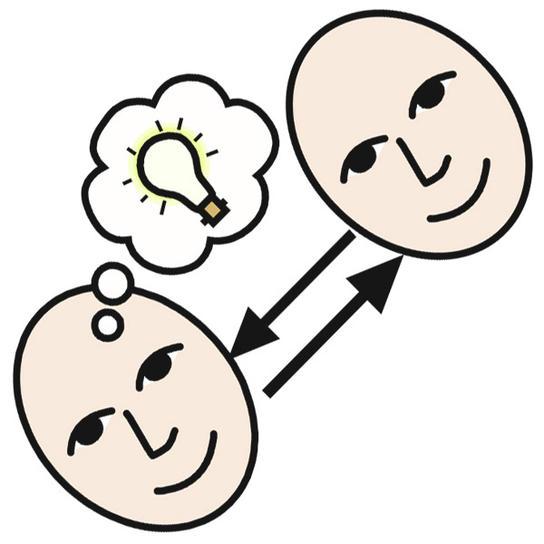
Using CC Material
Always give credit where credit is due!
Use a citation like below
OR
Add an Icon generated by creativecommons.org
“Share” by AJC1 CC: BY-NC-SA 2.0 (Flickr)

Slide 6
Finding CC Material
Search Engines
Google Image Search
Images.google.com
Reverse search engine helps you locate items you previously saved or used
Tin Eye
(Tineye.com)
Same as Google Image Search
Creative Commons Search engine
Search.creativecommons.org

Slide 7
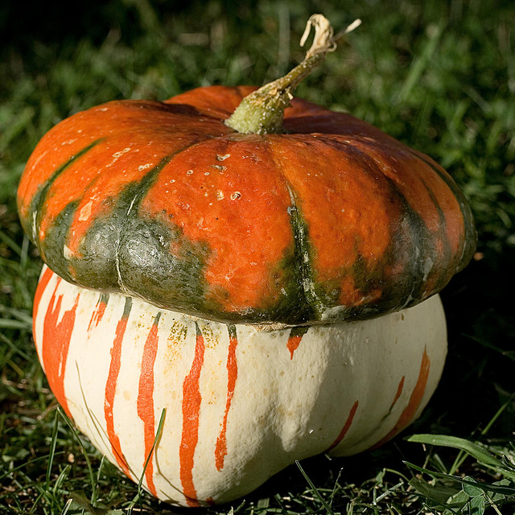
What results come up when you search for this image?
What are its licensing restrictions?

Slide 8
Finding CC Material pt. 2
Built ins and add-ons
Weebly
Built in CC searching
OpenAttribute
Openattribute.com
An app that can be downloaded and used to find and cite CC Material for personal sites, Wordpress, etc.

Slide 9
Learning More about CC
P2PU School of Open
P2pu.org/en/schools/school-of-open
Work through modules to learn more in depth content around Open Access and CC.
Open.Michigan Research Guide
Workshop Resources
The Presentation and Resource links can be found at my site: victorialungu.weebly.com
OR
Feel free to email me: vlungu@umich.edu

Slide 10
Questions?
Comments?
Thank you!

